Slide 1

Stock Price Analysis and Forecasting
An Analysis Using LSTM, ARIMA,
SARIMA Models, and
a Streamlit App

Slide 2
Introduction
Objective:
aims to analyze historical stock prices and forecast future values using advanced time series models.
Data Source:
The analysis uses stock price data for MRF.NS .
MRF.NS.csv

Slide 3
Data Overview
Dataset: MRF.NS.csv
Features: Open, High, Low, Close, Adj Close, Volume
Data Summary: Overview of dataset statistics and missing values.

Slide 4
Data Preparation
Handling Missing Values: Forward fill method
Data Splitting: Training and test sets

Slide 5
Exploratory Data Analysis (EDA)
Visualizations:
Stock price plot
Pair plots of features

Slide 6
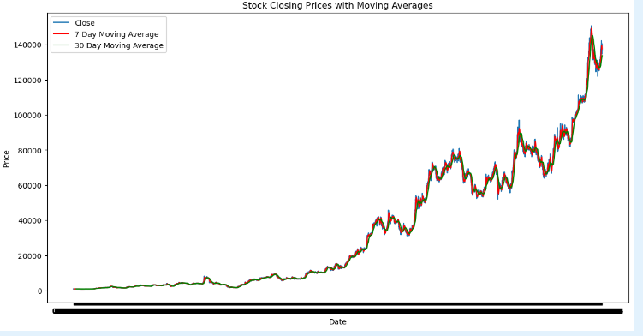
Moving Averages
7-Day and 30-Day Moving Averages:
Visual representation of moving averages
Interpretation of trends

Slide 7
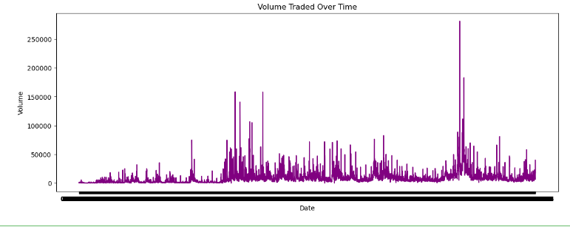
Volume Trends
Volume Traded Over Time:
Visualization of volume trends

Slide 8
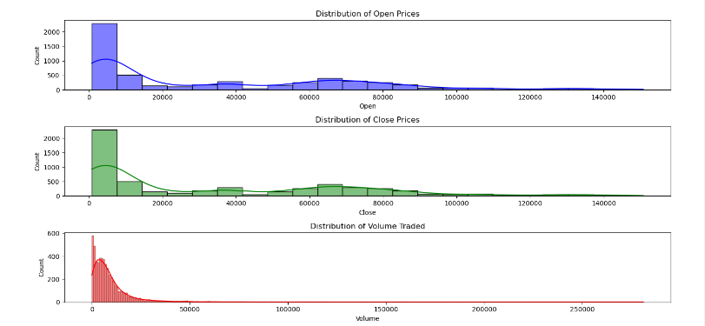
Distribution Plots
Histograms and KDE:
Distribution of Open, Close, and Volume

Slide 9
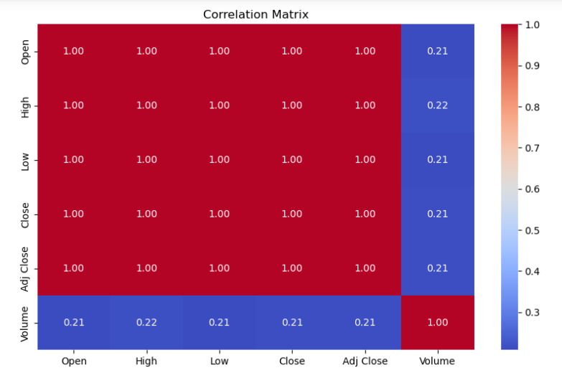
Correlation Analysis
Correlation Matrix:
Heatmap of feature correlations

Slide 10
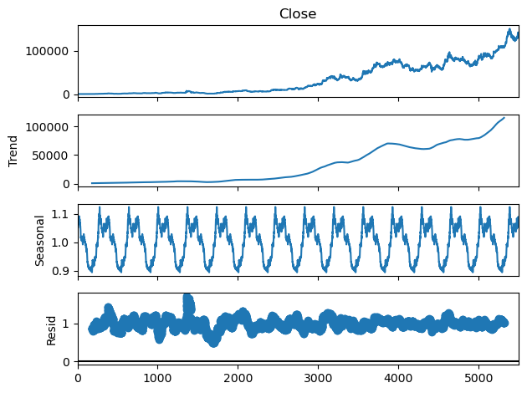
Seasonal Decomposition
Decomposition of Stock Prices:
Trend, seasonality, and residuals

Slide 11
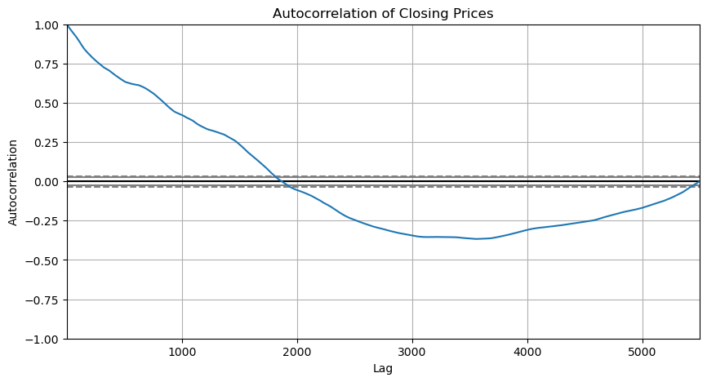
Autocorrelation Plot
Autocorrelation of Closing Prices:
Visualization and interpretation

Slide 12
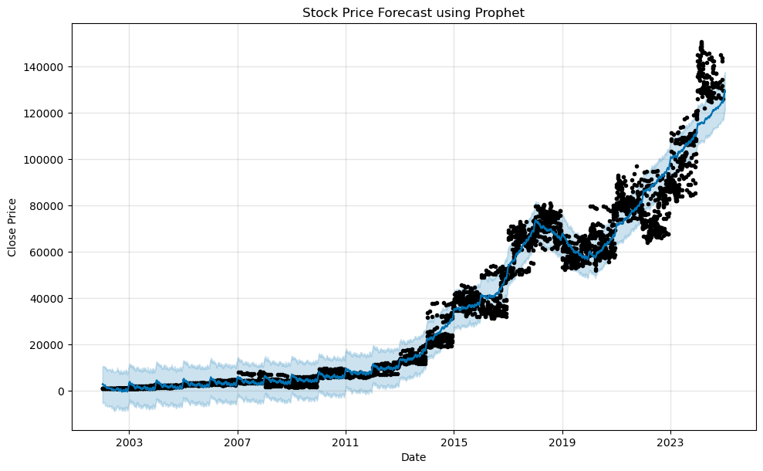
Prophet Model Overview
Prophet Model Setup:Data preparation
Forecasting method

Slide 13
LSTM Model Overview
Architecture: LSTM layers with Dropout
Training Parameters: Epochs, batch size

Slide 14
LSTM Model Results
Training and Testing Results:
Predictions and RMSE
RMSE:2.7848439804219697

Slide 15
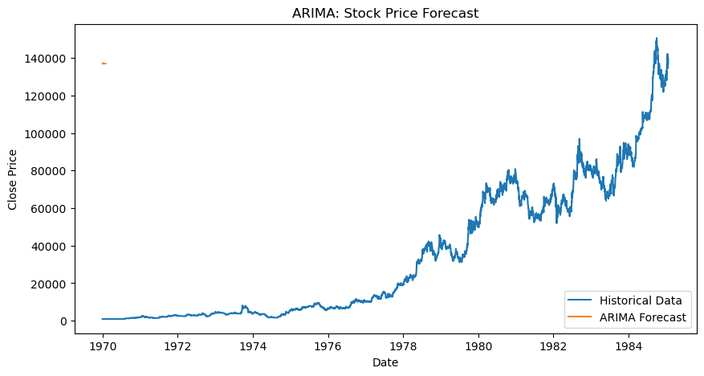
ARIMA Model Overview
ARIMA Parameters: p, d, q
Forecasting Methodology

Slide 16
ARIMA Model Results
Forecast Plot:
30-day forecast vs. actual data
Evaluation Metrics: RMSE
RMSE: 2.9544550357936332

Slide 17
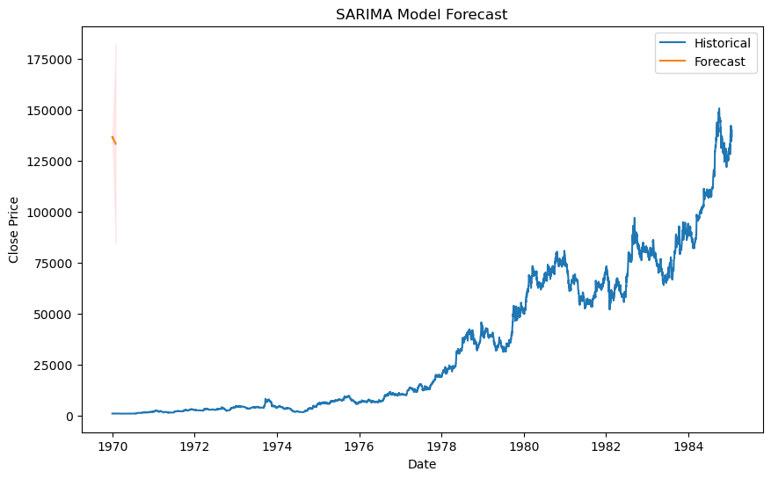
SARIMA Model Overview
SARIMA Parameters: (p, d, q, P, D, Q, m)
Model Fitting and Forecasting

Slide 18
SARIMA Model Results
Forecast Plot:
30-day forecast with confidence intervals
Residual Diagnostics and MSE
RMSE: 3.76744520916

Slide 19
Streamlit App Features
App Components:
Stock selection
Prediction period
Forecast visualization
Prediction for specific dates

Slide 20
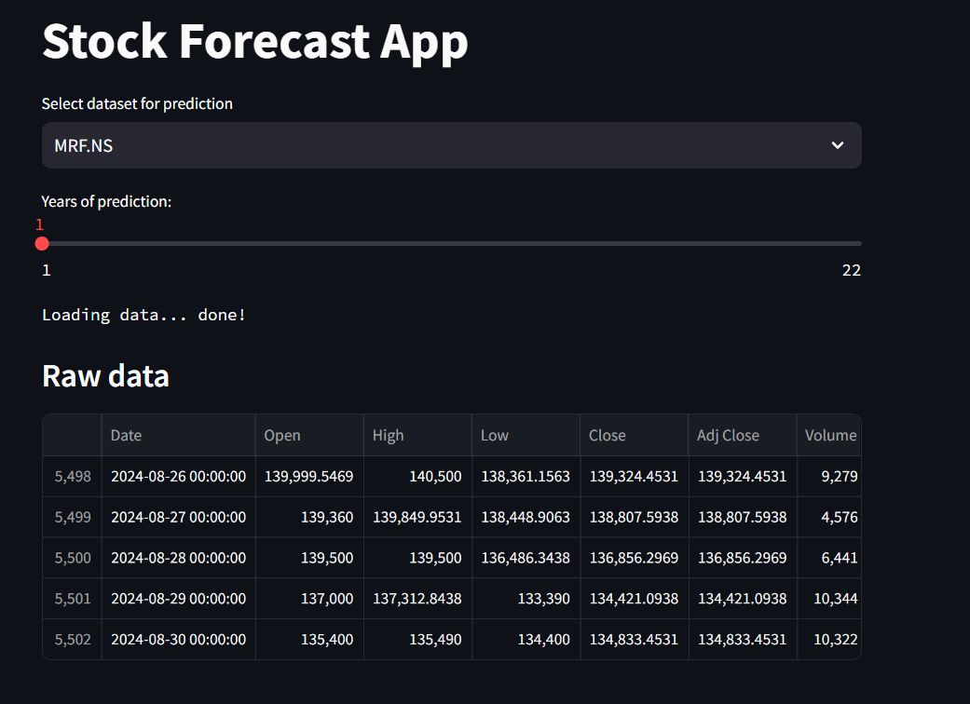
Streamlit App: Data and Forecasts
Data Display:
Raw data
Forecast Display:
Forecast plots and components

Slide 21
Model Comparison
Comparative Metrics:
RMSE (LSTM), MSE (ARIMA, SARIMA), forecast accuracy (Prophet)
Visual Comparison:
Forecast plots from each model

Slide 22
Insights and Findings
Key Takeaways:
Performance of each model
Observed trends and patterns

Slide 23
Future Work
Potential Improvements:
Model enhancements
Additional features and data
Additional Models:
Hybrid models
Advanced techniques

Slide 24
Deployment and Use Cases
Real-time Predictions:
Integration into trading platforms
API Development:
Serving predictions

Slide 25

Thank You!

